Slide 1
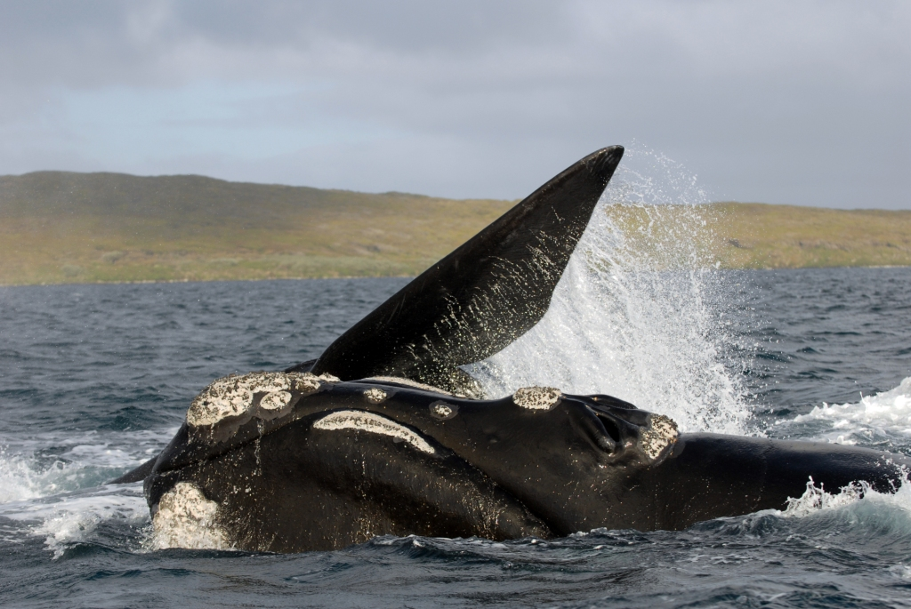
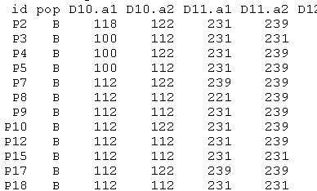
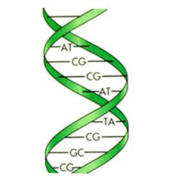
Trace-Contrast models for capture-recapture without capture histories
Rachel Fewster
Ben Stevenson, David Borchers St Andrews
Helen Nathan UoA

Slide 2
Conventional Capture-Recapture
Conventional Capture History (one animal):
0 1 0 0 1 0
Not seen time 1
Seen time 2
Not seen time 3
...
K=6 capture occasions
Somehow we can recognise the same animal when we encounter it again

Slide 3
Conventional Capture-Recapture
Data are the capture histories of all animals caught at least once:
0 1 0 0 1 0
1 0 0 0 0 0
0 0 0 0 1 1
0 0 1 0 0 0
The pattern of 0s and 1s in the observed data enables us to estimate the number of
0 0 0 0 0 0
histories...
... and so the total population size.
...

Slide 4
A new sort of capture-recapture
New technologies for animal recognition create exciting new opportunities for capture-recapture studies:
  DNA samples, photo-ID, acoustic recognition, drones, satellites...
Opportunity to collect more samples than ever before
But there is uncertainty in individual identity: we don’t know for sure if two samples come from the same animal

Slide 5


A field of apple trees

Slide 6
We want to know how many trees there are, but we can only see apples

Slide 7
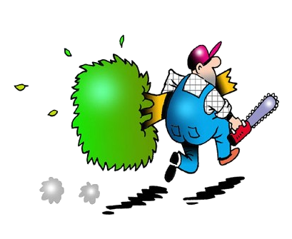

Slide 8
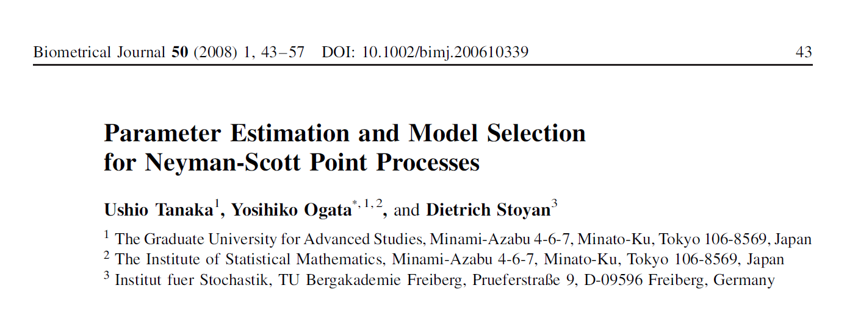
Method of Tanaka, Ogata & Stoyen Biometrical Journal 2008
How to count trees when all you can see is apples
No straightforward likelihood computation available
Tanaka et al propose a “Palm Likelihood” approach based on the difference or contrast process

Slide 9


Example: Thomas Process
Unobservable trees: Poisson(μ)
Aim is to estimate μ, ν, σ
Apples per tree: Poisson(ν)
Apple dispersal: iid Normal(0, σ² I)

Slide 10
Example: Thomas Process
Unobservable trees: Poisson(μ)
Trees are individual animals: μ = population density
Aim is to estimate μ, ν, σ
Apples are detections or traces of each animal
Apples per tree: Poisson(ν)
Apple dispersal: iid Normal(0, σ² I)
Different traces from the same animal tend to be similar
If we knew for sure which apples belong to the same tree, this would be capture-recapture...
– but we don’t

Slide 11
The contrast process
Consists of all pairwise distances between points, or contrasts between samples
r₁
r₂

Slide 12
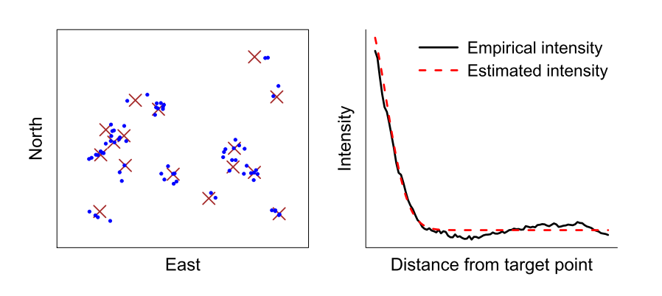
Intensity of the contrast process
Peak at close range due to siblings : apples from the same tree / traces of the same animal
Background intensity of non-sibs : apples from different trees / traces of different animals
intensity of points
pairwise distance between apples, r

Slide 13
Intensity of the contrast process
Peak at close range due to siblings : apples from the same tree / traces of the same animal
Related to ν
Background intensity of non-sibs : apples from different trees / traces of different animals
μν
Related to σ

Slide 14
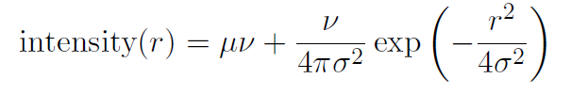
Natural to estimate μ, ν, σ by constructing an objective function from this intensity
Tanaka et al propose the likelihood from an inhomogeneous Poisson process as the objective function
Related to ν
Related to σ
μν
pairwise distance, r

Slide 15
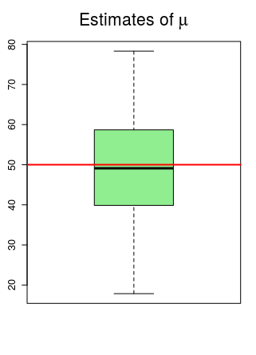
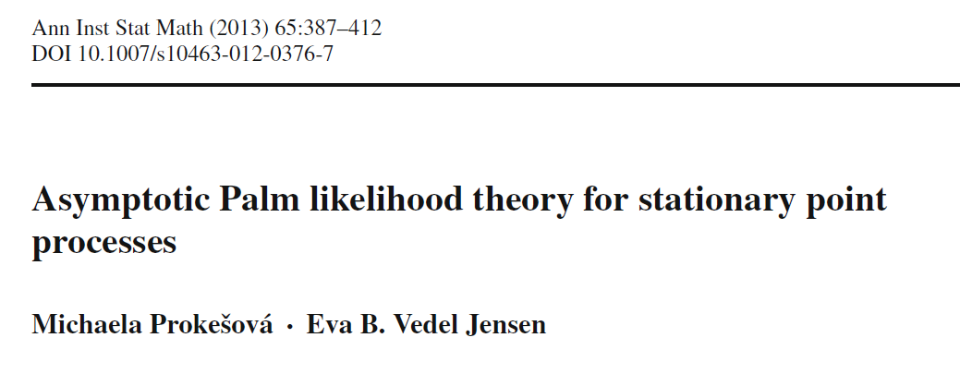
Does it work?
Yes!
Fast, accurate estimation of μ, ν, σ (within reason)
Very easy to code
One of three methods for fitting clustered spatial point processes in Spatstat
Prokešová & Jensen (2013) proved asymptotic consistency

Slide 16
Why is this relevant?
Process of matching pairs of samples is exactly what ecologists do before constructing capture histories:
  Match photographs, or genotypes, or time-stamps, or locations, ...
  Make ‘threshold’ decisions about which samples correspond to the same animal, then reconstruct capture histories
So why bother with capture histories...?
... sometimes they’re just a nuisance...?

Slide 17
We just want to know how many trees!
We don’t care which apples belong to which trees

Slide 18
Why is this relevant?
Estimation without elicitation makes it fast:
  No need for latent variables describing cluster centres or cluster membership
Using Poisson process likelihood as objective function makes it extendable:
  Incorporate additional information about samples: as for ‘marked’ point processes
  Partially marked populations – easy!
  Sometimes our chief interest is in the extras

Slide 19
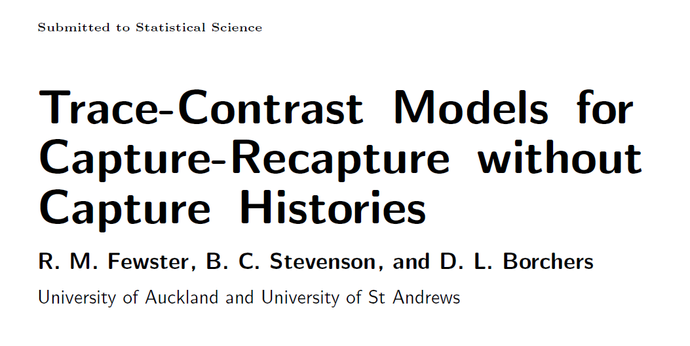
Trace-Contrast Models
Jointly with Ben Stevenson and David Borchers:
  Special Issue of Statistical Science: 50th anniversary of Cormack-Jolly-Seber models
Palm likelihood approach clearly relevant when animal identity information comes from spatial location or time

Slide 20
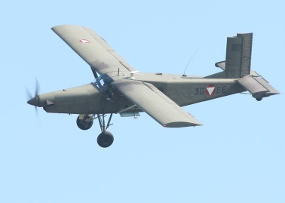

Identity information from spatial location
  Two planes or drones in succession
Plane 1

Slide 21
Identity information from spatial location
  Two planes or drones in succession
Or a succession of pictures from one mount?
Plane 2
Same whale as seen by Plane 1, or different?
2 minutes...

Slide 22
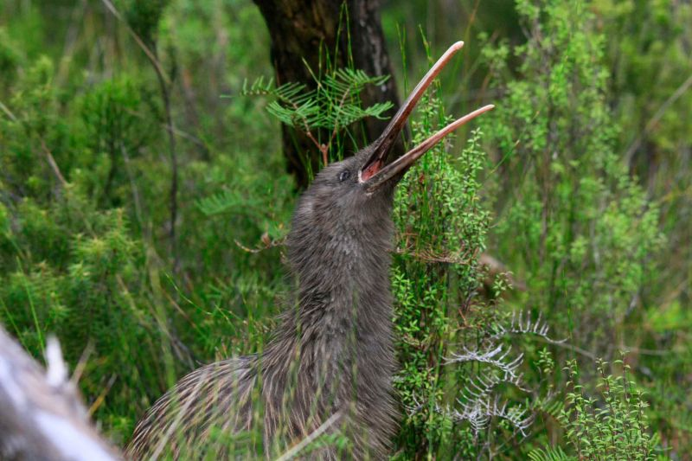
Identity information from spatial location
  Acoustic recognition by triangulation
‘Additional info’ could include acoustic trace measurements relevant to individual identity

Slide 23
Can we use trace-contrast models for capture-recapture from photo-ID or DNA samples?

Slide 24
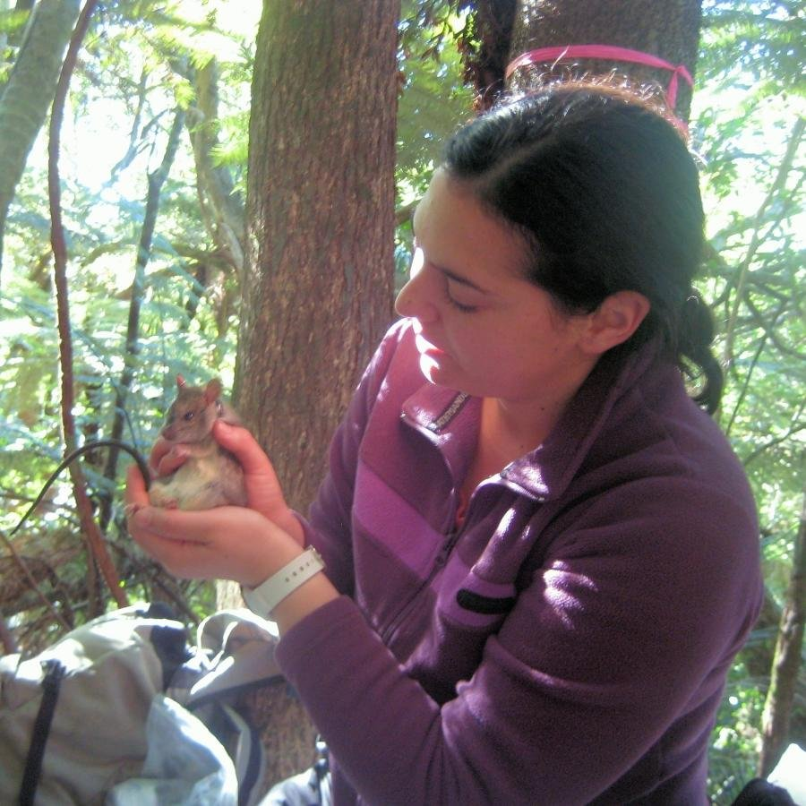
Example: Ship Rat behaviour
Rats are invasive pests in New Zealand
This study looked at rat behaviour around control devices: bait stations, snap traps, tracking tunnels
  Helen Nathan
Question: when a rat encounters a device, what is the probability it goes in?

Slide 25
Example: Ship Rat behaviour
Problem:
What is an ‘encounter’?
We don’t want to have to define this arbitrarily...
Question: when a rat encounters a device, what is the probability it goes in?

Slide 26
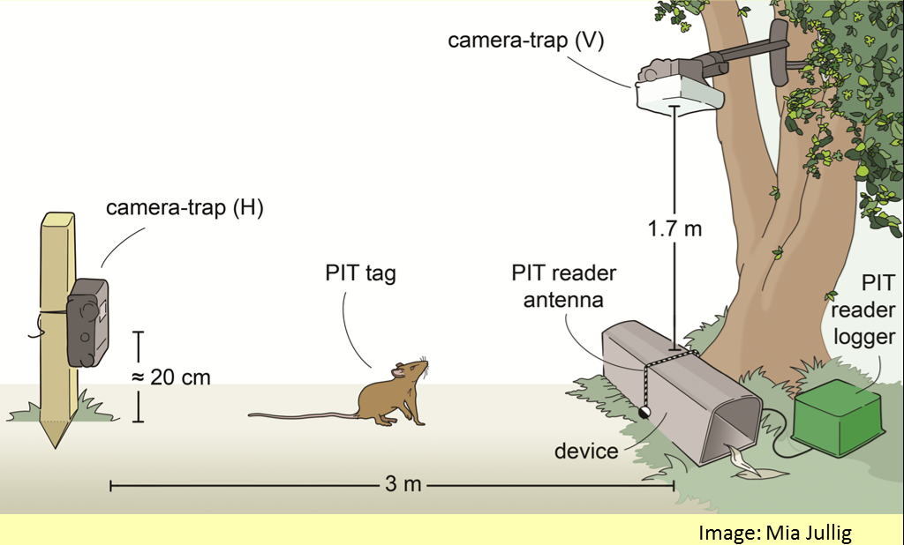
Example: Ship Rat behaviour
Camera 2
Camera 1

Slide 27
Trace-Contrast Behaviour Model
Unobservable trees are Encounters:
Each encounter is an approach of one rat to the station
Time (1-dimensional)
Observations (apples) are detections of the encounter by the two cameras (red & blue)

Slide 28
Trace-Contrast Behaviour Model
Unobservable trees are Encounters:
Each encounter is an approach of one rat to the station
Scenario is like capture-recapture: we are investigating a property of encounters from multiple detections of the encounter linked by proximity in time.
Encounters can overlap (important).

Slide 29
Trace-Contrast Behaviour Model
Unobservable trees are Encounters:
Each encounter is an approach of one rat to the station
Two types of Encounter (tree):
Interaction Encounter, I
  the rat interacts at some point, whether observed or not;
Non-interaction Encounter, non-I

Slide 30
Aim is to estimate the PROPORTION of Interaction-Encounters (plum-trees)
  We get information about I versus non-I by those videos that DO detect the interaction
Two types of Encounter (tree):
Interaction Encounter, I
  the rat interacts at some point, whether observed or not;
Non-interaction Encounter, non-I

Slide 31
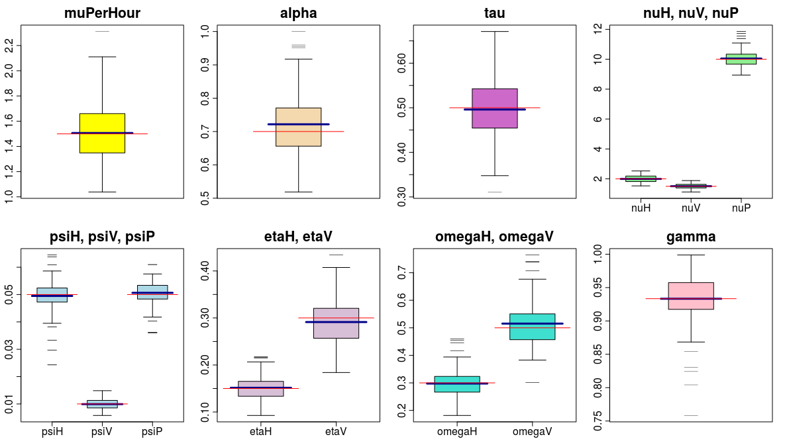
Complicated model
Works with simulated data
Robustness to model specification needs investigating

Slide 32
Bait stations get a lot of activity (large bait stock) and often a high interaction rate
Results : P(interact) by station-night
Snap traps (non-live): much less activity and often a low interaction rate

Slide 33
Tracking tunnels – innocuous; middling activity; typically high interaction rate
Results : P(interact) by station-night

Slide 34

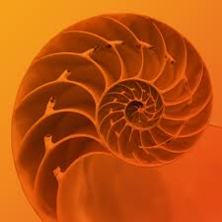
Summary
New technologies create huge opportunities for capture-recapture: which species we can monitor and how many samples we can collect
Uncertain identity is intrinsic
New ways of thinking about capture-recapture might be helpful
Funded by the Royal Society of New Zealand Marsden Fund

