Slide 1

AUCKLAND UNIVERSITY STATISTICS DEPARTMENT
16 NOVEMBER 2012

Slide 2
WHAT WE’LL COVER
Who is Datamine?
What does Datamine do?
What’s it like at Datamine?
What do Datamine’s geeks do?
What’s on offer and who do we need?

Slide 3
WHO IS DATAMINE?
Established in 1995, we are experts in business and marketing analytics
Help our clients unlock the potential of their data and use it to support decision making and develop smart data-driven strategies/tactics that add real value
Recognition in New Zealand and overseas in technical and business awards
Clients from New Zealand, Australia, and Asia are serviced from Auckland
Datamine’s key objective is to help our clients excel in their industry through the use of smart data-driven strategies

Slide 4





















WHO ARE OUR CLIENTS?

Slide 5
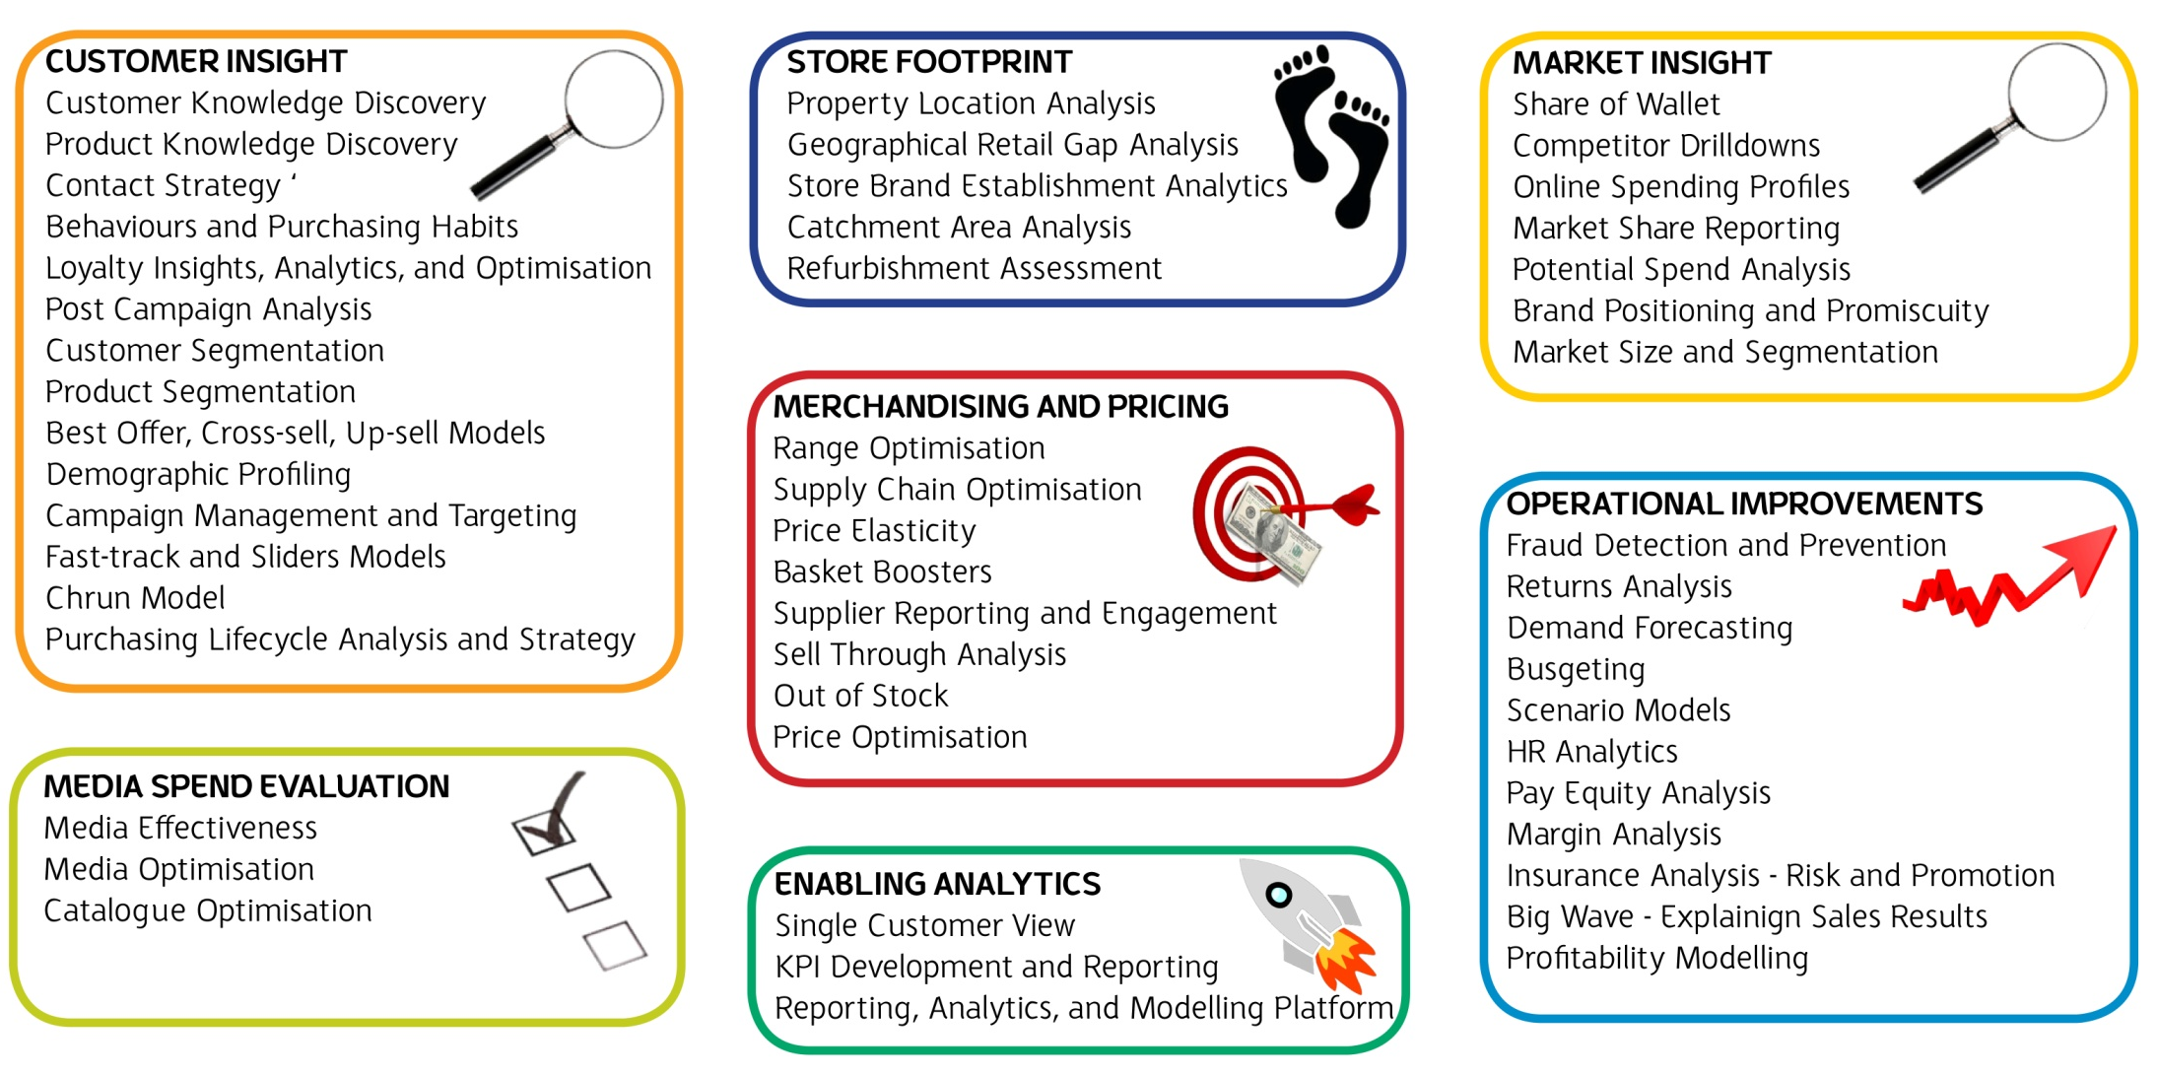
WHAT DOES DATAMINE DO?

Slide 6
DATAMINE’S SKILL SET
Datamine has a wide skill set and extensive experience working in a range of industries
The foundations of this are
Statistics and Operations
Research
Business and Marketing
Business management
Marketing management
Marketing/Corporate Communications
Statistics
Predictive modelling
Artificial intelligence
Neural networks
Optimisation
Segmentation
Information Technology
Systems
Computer sciences
Databases
Programming
Data warehousing

Slide 7
WHAT DO THE ANALYTICAL GEEKS DO?
Understand the business problems
Project planning and brainstorming
Doing technical work
  Gathering the data and transforming
  Problem solving and reporting
  Statistical analysis
  Statistical modelling
  Using R, databases, Excel, Unix scripts and the SAS language
  PC and server based analytics
  Presentation of results
Mentoring, quality assuring, and guiding other analysts
Development of new tools and solutions
Sharing experiences and project outcomes

Slide 8

DO WE REALLY GET INTO HARD PROBLEMS?
Absolutely! In the last month, our technical team has had to battle with the following (among other things…)
  The assumptions underlying survival analysis and churn propensity modelling
  Variable selection with thousands of candidate variables
  Association rules in data mining
  Time shifting of customer behaviour
  Robust regression modelling techniques
  Optimising code on databases of hundreds of millions of rows
  How can we tie huge amounts of data from different client systems together?
  How do we deal with the missing 2011 Census data?
  How do we project the time between customer behavioural events?
  Refining our in-house R graphics and libraries of custom functions

Slide 9
WHAT DO THE ANALYTICAL GEEKS DO?
Case Study

Slide 10
DEPARTMENT OF CORRECTIONS CASE STUDY
The Challenge
New Zealand prisons have at times been operating over capacity, with more prisoners than beds, and the number of inmates is expected to continue to increase
Corrections approached Datamine to help them build a robust business case for Treasury, estimating the extra staff funding which was needed to cover the expected increase in the number of prisoners
Corrections had observed a fairly linear relationship between the number of inmates and prison officers, up to a certain point. However, when the facilities are close to full, more staff time is needed for activities like finding temporary accommodation and co-ordinating prison transfers

Slide 11
DEPARTMENT OF CORRECTIONS CASE STUDY
Corrections asked Datamine to help them quantify the number of prison officers required to manage prison population, as forecast by the Ministry of Justice
The Solution
Datamine recommended a data-driven, evidence-based approach to ensure a sound business case
Payroll data was used to compare the actual number of hours worked with the number of inmates and the capacity of each facility
Together with the forecast from the Ministry of Justice, this was used to predict the future staff costs associated with the increasing number of prisoners

Slide 12
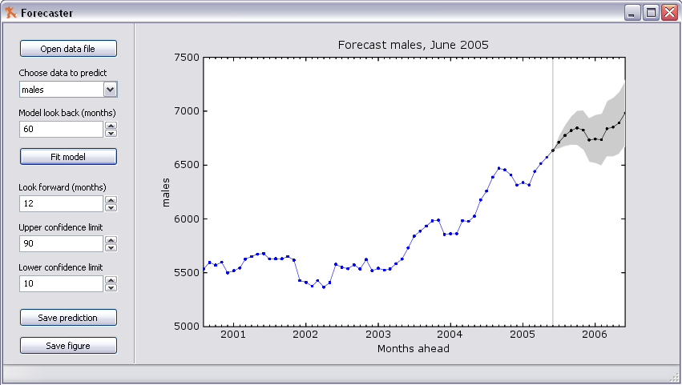
DEPARTMENT OF CORRECTIONS CASE STUDY
The Results
Staff costs increased from less than $380 per prisoner per week when occupancy was below 99% to over $420 per prisoner per week when occupancy rose to over 102%
When the prisons are nearly full, a 3% increase in the number of prisoners results in a 13% increase in staff costs

Slide 13
CURRENT VACANCIES
Datamine is currently seeking 1-2 statistical analysts
  Full time roles for graduates
  Preferably with post-graduate statistics
  Preferably with some computer science, math, logic and business courses
Datamine and the Auckland University Statistics Department are talking about potential for
  Postgraduate projects
  Internships
  Scholarships
  ‘Top Student’ prizes

Slide 14
WHAT WOULD IT BE LIKE IF YOU JOINED US?
Datamine is definitely not the place if you want to cruise!
The data will be messy and uncertain! And often you’ll have limited domain knowledge so a bit of research and digging is needed upfront
We all need to be resourceful – often there’s no “right answer” and you have to think carefully to build your own rules, logic and definitions for analysis
We’re about passion, productivity and creativity – everyone works hard but we always plan our work in advance to make it as efficient as possible
You’ll be well supported so there aren’t hours toiling away over frustrating code … but you have to try and figure it out for yourself first
Datamine expects you to push yourself, keep learning constantly and share your knowledge with the team
Yes, you probably will have to defend your modelling approach and assumptions to someone with a PhD … but they’ll also help you implement any improvements and produce someone that’s actually useful to our clients
You can look back on a year and be amazed at what you’ve learnt and the exciting opportunities ahead!

Slide 15
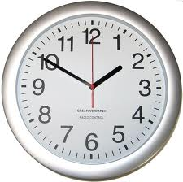


A DAY IN THE LIFE OF A GRADUATE
Check my overnight code run worked? Success! Review results
Team catch up to go through our current projects and progress, make sure we’re all on track
Get stuck into a customer behaviour project I’m working on for one of NZ’s biggest companies – understanding their data structures, massaging the data into shape for analysis, creating my own custom functions in MySQL
Team Huddle – We get together for a few minutes everyday to share our technical ‘blocks’, I get some coding help from one of our senior whizzes
Free delicious lunch! (Yes, everyday at Datamine)
Switch gears to an ongoing modelling project, some new data has arrived to understand and incorporate
Catch up with our Client Services team – some strategic thinking for an exciting new project
Back to my modelling, automate the production of hundreds of graphs for review tomorrow
Cookies in the office!
Set up code scripts to run a job overnight
Walk with the Datamine girls and then home!

Slide 16
INTERESTED?
Please have a chat with us after this presentation, or check out
www.datamine.com

